Slide 1
Computer Vision and Artificial Intelligence
By: J. Klimack

Slide 2

What is Artificial Intelligence?

Slide 3
What is Artificial Intelligence?
Machines that can:
Learn
make decisions
Make Predictions
Recognize patterns
Goal: Simulate human intelligence

Slide 4
Applications of AI

Slide 5
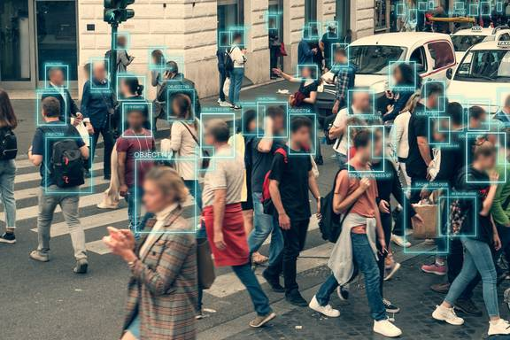
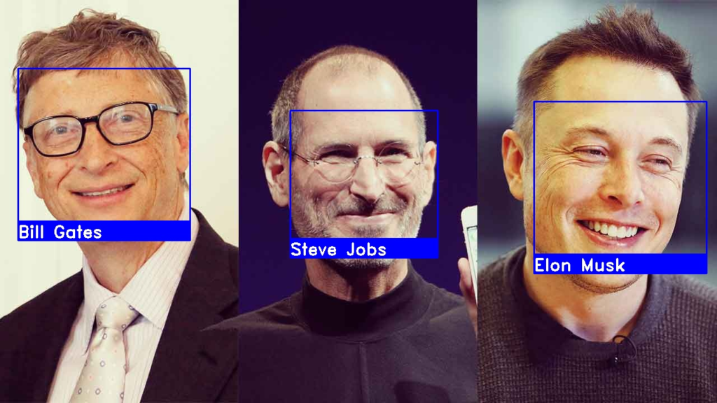
Facial Recognition
Detecting faces in an image
Naming the person in the photo

Slide 6

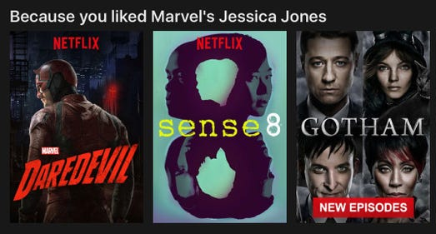
Recommendation Systems
Make suggestions based off user preferences, likes/dislikes, and viewed content

Slide 7




Personal Assistants
Apple Siri
Google Assistant
Microsoft Cortana

Slide 8
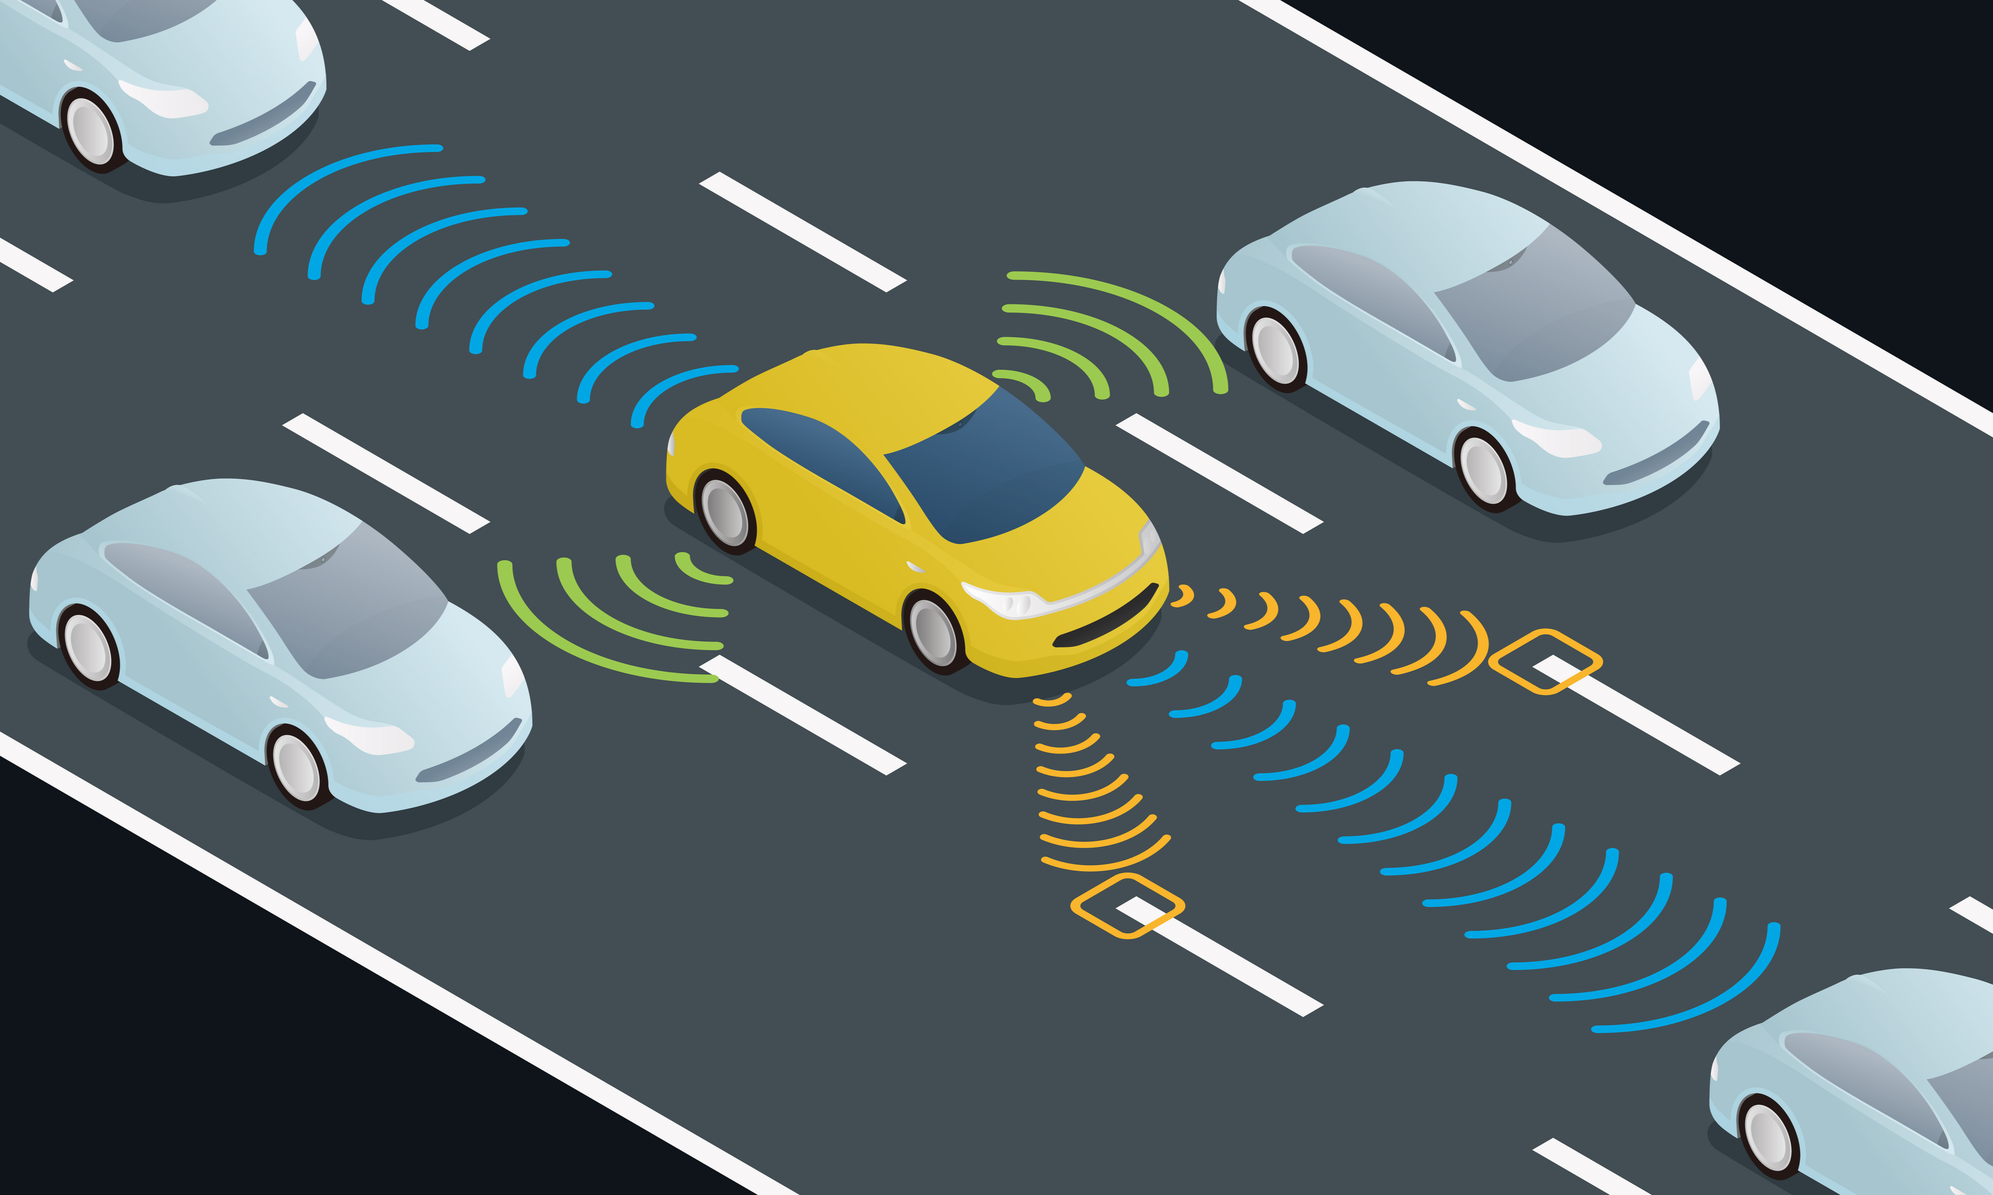
Autonomous Vehicles
The vehicle needs to be able to sense and understand driving conditions and traffic to drive safely

Slide 9
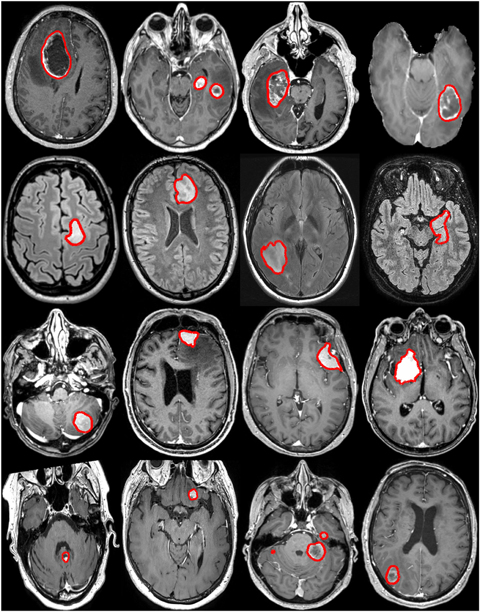
Healthcare
Help detect diseases and cancer in medical images

Slide 10
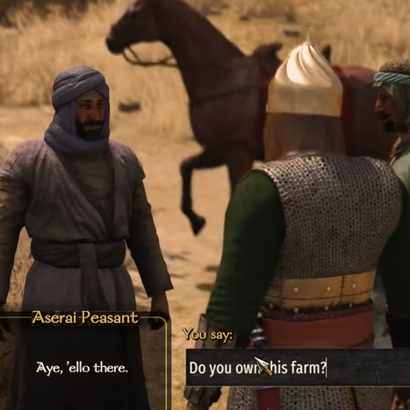
Gaming
Creating NPCs (bots) that can better communicate with human characters
Generating 3D Models

Slide 11
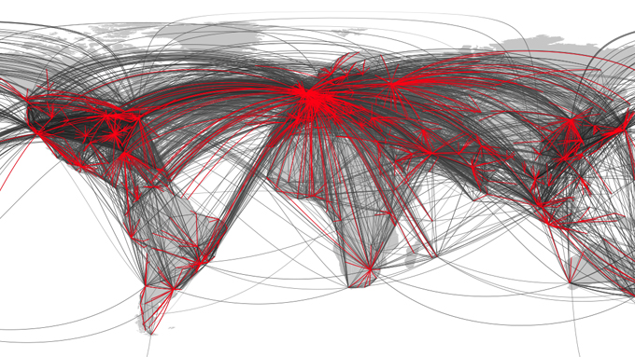
Simulations
Modelling real-world scenarios to determine possible results
Epidemic tracking

Slide 12
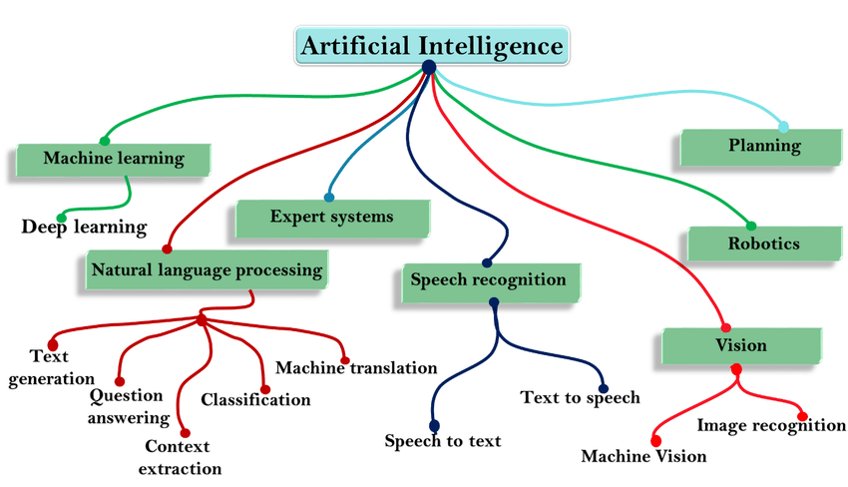

Slide 13
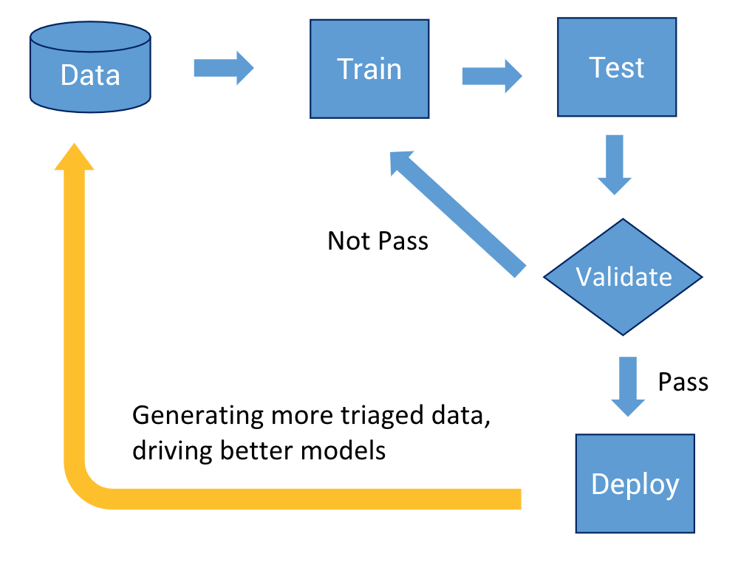
How an AI learns: Part 1
Provide example problems with the correct solutions
Data!
Train
Test
Repeat until it is capable of getting the correct answer
Can take forever to train…

Slide 14
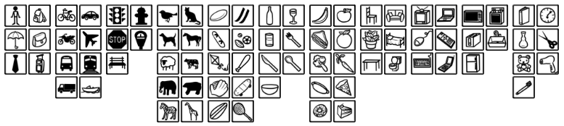
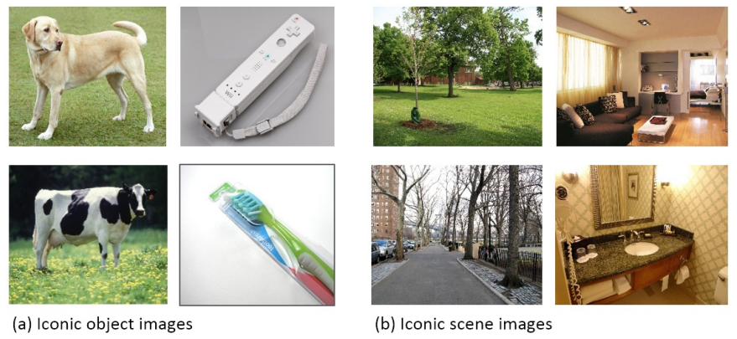
COCO Dataset
123,287 labelled images
91 categories

Slide 15
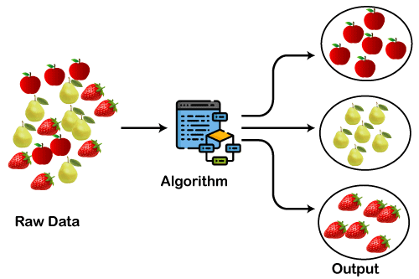
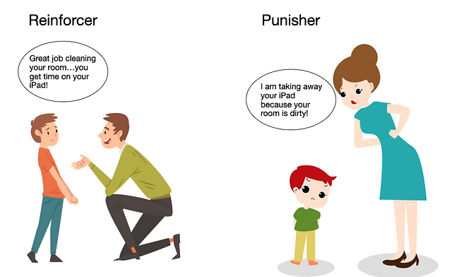
How an AI Learns: Part 2
Clustering
Grouping similar characteristics together
Reinforcement Learning
Rewarded/Punished based on actions

Slide 16
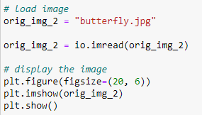
Coding
AI is a subfield of computer science which does involve writing code from time to time…

Slide 17
Computer Vision
It is the branch of AI that deals with digital images and videos
It allows computers to understand and manipulate visual data
Programs like Photoshop use many computer vision techniques to perform various tasks

Slide 18
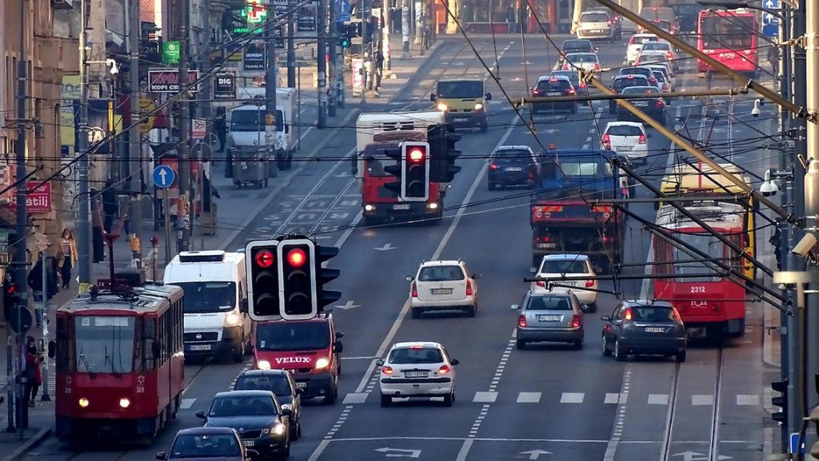
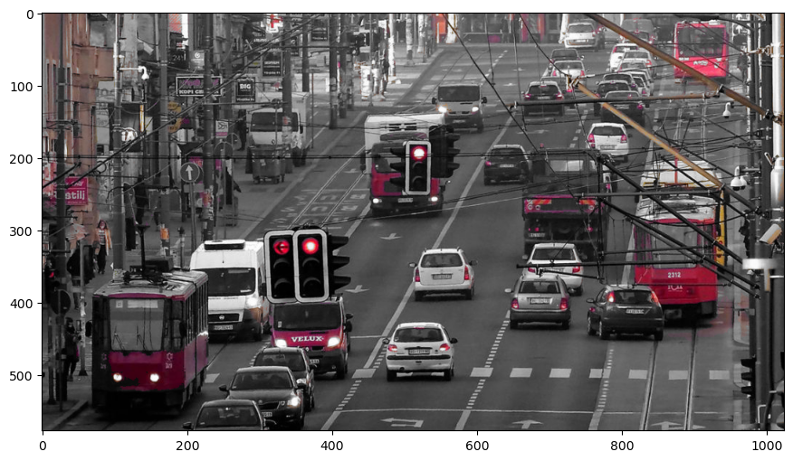
Color Accents
Black and White image except one color

Slide 19
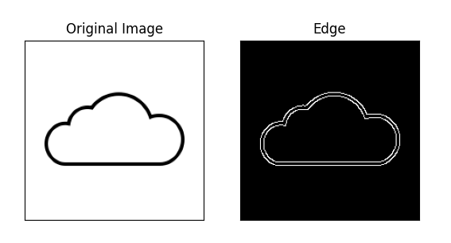
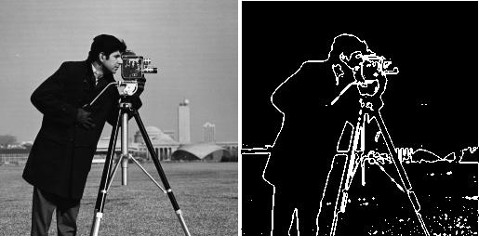
Edge Detection
Finding important edges between different colors or features in an image
Manufacturing:
Laser cutter
Cricut / die-cutter
Engraver

Slide 20
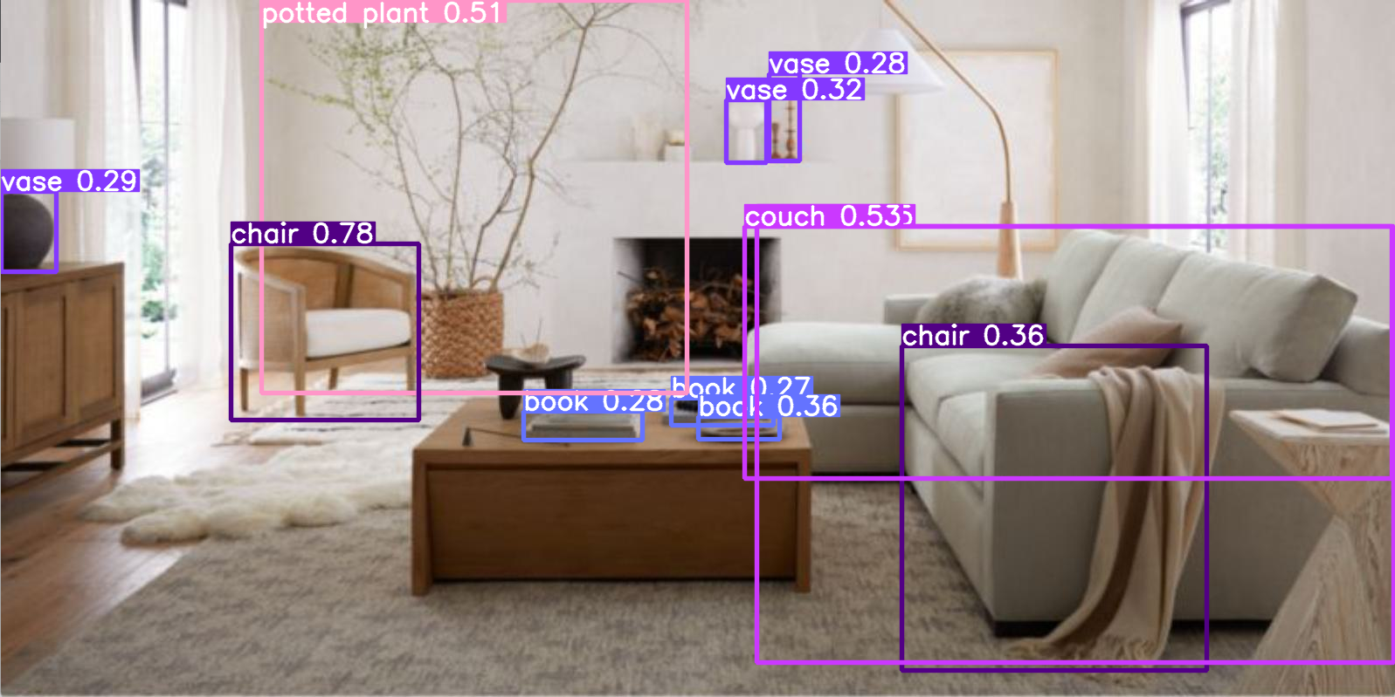
Object Detection / Classification
Locating objects in a scene
Labelling those objects
YOLO
Trained on COCO dataset

Slide 21
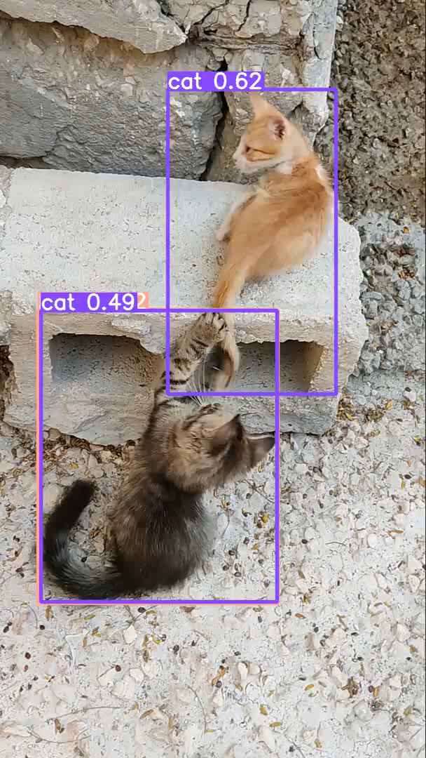
Object Detection Video
Can also locate objects at real-time in a video
Video tracking
Surveillance

Slide 22
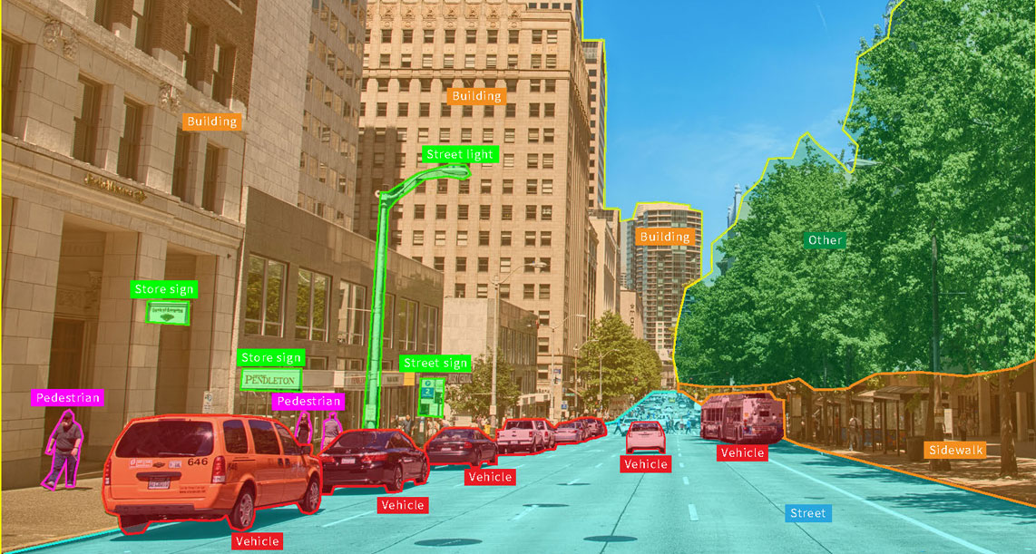
Object Segmentation

Slide 23

What is a Digital Image?
Computers can’t actually “see”
They only understand numbers

Slide 24
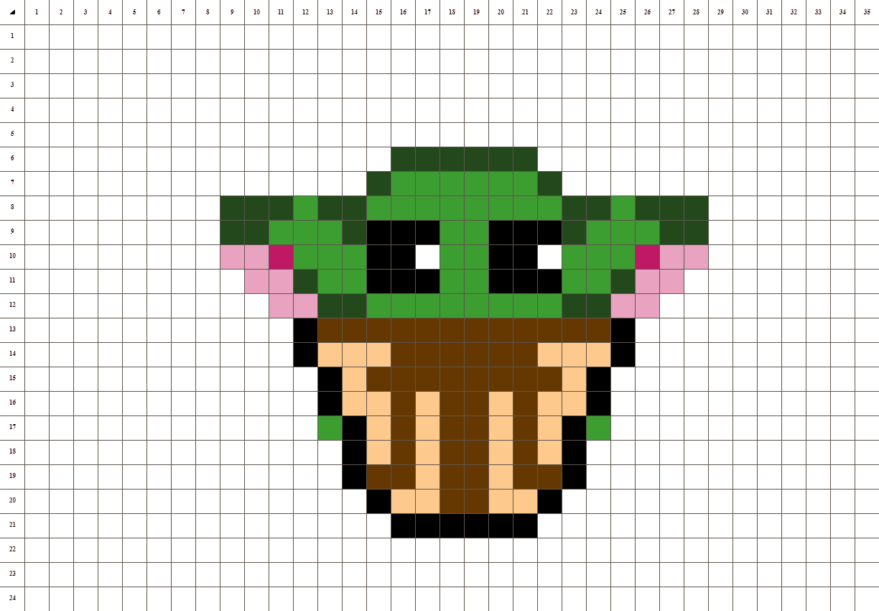
Pixels
Images are made up of a grid of colors
Each cell in that grid is called a pixel
Each pixel has three numbers from 0-255 (intensities):
R – Red
G – Green
B – Blue
Red = [255, 0, 0]

